Slide 1
Raindrop Sensor interfacing with Beaglebone Wireless
Submitted By:Ajay Kumar vattikonda
Group 1

Slide 2
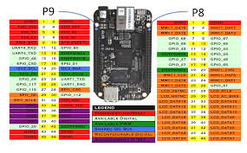
Beaglebone Wireless

Slide 3
Beaglebone Wireless
The BeagleBones are a line of affordable single-board Linux computers (SBCs) created by Texas Instruments.
Replacing the 10/100 Ethernet port with onboard 802.11 b/g/n 2.4GHz WiFi and Bluetooth, the popular open source BeagleBone™ Black computer now comes with built-in wireless networking capability. Leveraging a partnership with Octavo Systems and designed in CadSoft Eagle, BeagleBone™ Black Wireless is the easiest to use and modify credit-card sized IoT Linux computer available.

Slide 4
Beaglebone Wireless
Leveraging a partnership with Octavo Systems, BeagleBone™ Black Wireless is the easiest to use and modify credit-card sized IoT Linux computer.
Like BeagleBone Black, Wireless retains HDMI output, serial debug port, PC USB interface, USB 2.0 host, reset and power buttons, and adds two more status LEDs for WiFi and Bluetooth.
BeagleBone Wireless supports GPIO (digital), analog (ADC), PWM, UART (serial), SPI, and I2C pins.
The pin map colors indicate possible uses for the pins. The hardware allows only one kind of use at a time.

Slide 5
Beaglebone Wireless
Also retained is the 4GB of onboard eMMC memory with Debian Linux pre-installed, allowing BeagleBone Black Wireless to boot in around 10 seconds, and have you developing through your web browser in less than 5 minutes using just a single USB cable.
The board is open source and designed in CadSoft EAGLE.
BeagleBone™ Black Wireless is fully software, hardware and mechanically compatible with BeagleBone™ Black, and is even compatible with all existing BeagleBone™ Black capes for hardware expansion, integration, and peripherals.

Slide 6
Supporting Feature List
Processor (Integrated in the OSD3358):
AM335x 1GHz ARM® Cortex-A8:
SGS530 3D graphics accelerator
NEON general-purpose SIMD engine with floating-point acceleration
2x PRU 32-bit 200MHz microcontrollers
Memory:
512MB DDR3 800MHz RAM (Integrated in the OSD3358)
4GB 8-bit eMMC on-board flash storage with Debian pre-installed
microSD card slot

Slide 7
Keyword | Color | Use
GPIO | Light green | Digital (GPIO) pins unless you enable a shared interface.
AIN | Dark green | Analog input (ADC) pins. Always enabled.
PWM | Light brown | PWM output pins when you enable the PWM interface. Disabled by default. Enabled using enablePWM.
UART | Pink | Serial pins when you enable the serial interface. Disabled by default. Enabled using enableSerialPort.
SPI | Light blue | SPI pins when you enable the SPI interface. Disabled by default. spi0-1 enabled using enableSPI.
I2C | Dark brown | I2C pins when you enable the I2C interface. i2c-1 (index 2) enabled by default. i2c-2 (index 1) enabled using enableI2C.

Slide 8
Rain drop sensor
It is used for the purpose of rain detection. Advantage is that it can detect water beyond what a humidity sensor can detect.
The rain sensor module consists of rain board (PCB), control board (SENSOR MODULE), LED.
It consists of two modules, a rain board that detects the rain and a control module, which compares the analog value, and converts it to a digital value.

Slide 9
Pin configuration
Chip pins are:
S.No: | Name | Function
1 | VCC | Connects supply voltage- 5V
2 | GND | Connected to ground
3 | D0 | Digital pin to get digital output
4 | A0 | Analog pin to get analog output
5 | + | Integrated Chip +ve
6 | _ | Integrated Chip -ve

Slide 10
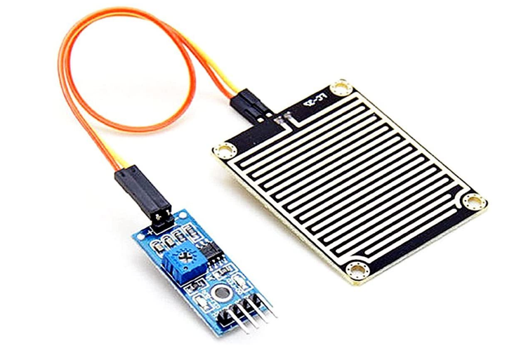
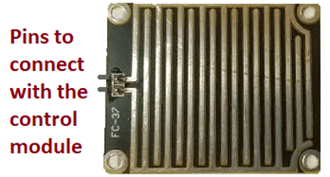
Pin configuration
Board Pins are:
+
–

Slide 11
Raindrop Sensor Features
Working voltage 5V
Output format: Digital switching output (0 and 1), and analog voltage output AO
Comparator output signal clean waveform is good, driving ability, over 15mA
Anti-oxidation, anti-conductivity, with long use time
With bolt holes for easy installation
Small board PCB size: 3.2cm x 1.4cm

Slide 12
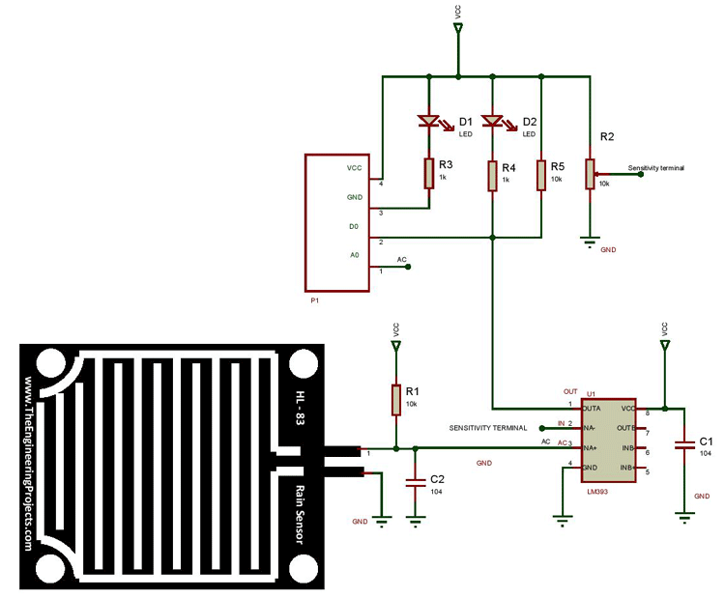
circuit diagram of a raindrop sensor module

Slide 13
Circuit Diagram
The R1 resistor and the rain board module will act as a voltage divider.
Capacitors C1 and C2 are used as a biasing element.
The resistors R3 and R4 will act as current limiting resistors.
The resistor R5 will act as a pull-up resistor to keep the bus in a high state when not in use.

Slide 14
Circuit diagram
Case1: When the input of the inverting terminal is higher than the input of the non-inverting terminal.
Case2: If the input of the inverting terminal is lower than the input of the non-inverting terminal.
When the surface of the rainboard module will be wet, and it offers minimum resistance to the supply voltage. Due to this, the minimum voltage will be appearing at the non-inverting terminal of LM393 Op-Amp.

Slide 15
Circuit Diagram
The comparator compares both inverting and non-inverting terminal voltages. If the condition falls under case(1), the output of the Op-Amp will be digital LOW. If the condition falls under case(2), the output of the Op-Amp will be digital HIGH.

Slide 16
Working
It works on the principal of resistance.When there is no rain drop on board. Resistance is high so we gets high voltage according to V=IR.
The rainboard module consists of copper tracks, which act as a variable resistor. It changes from 100K while being wet to 2M while being dry. When the board is wet, more current gets conducted.
Its resistance varies with respect to the wetness on the rainboard.
When rain drop present it reduces the resistance because water is conductor of electricity and presence of water connects nickel lines in parallel so reduced resistance and reduced voltage drop across it.

Slide 17
Working
Rain Sensor plate has two PCB tracks. These tracks are not connected. When water falls on the plate or board, resistance between tracks changes.
A dry rain board gives an analog output of 5V.

Slide 18
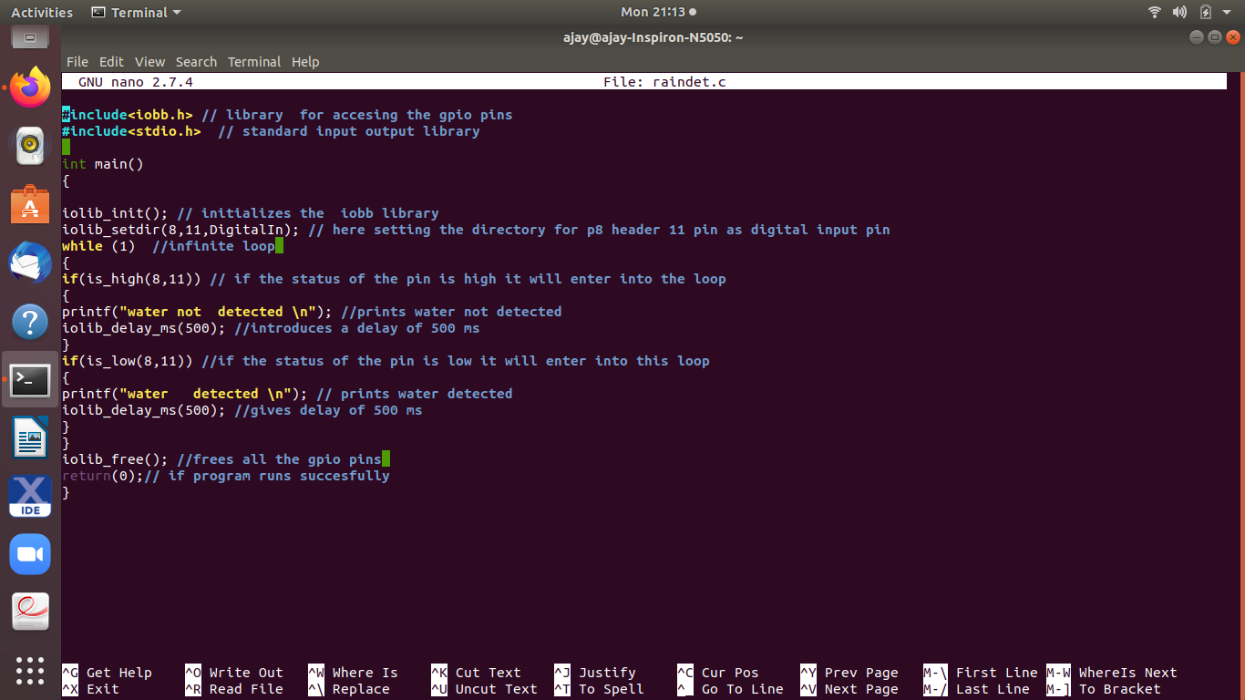

Slide 19
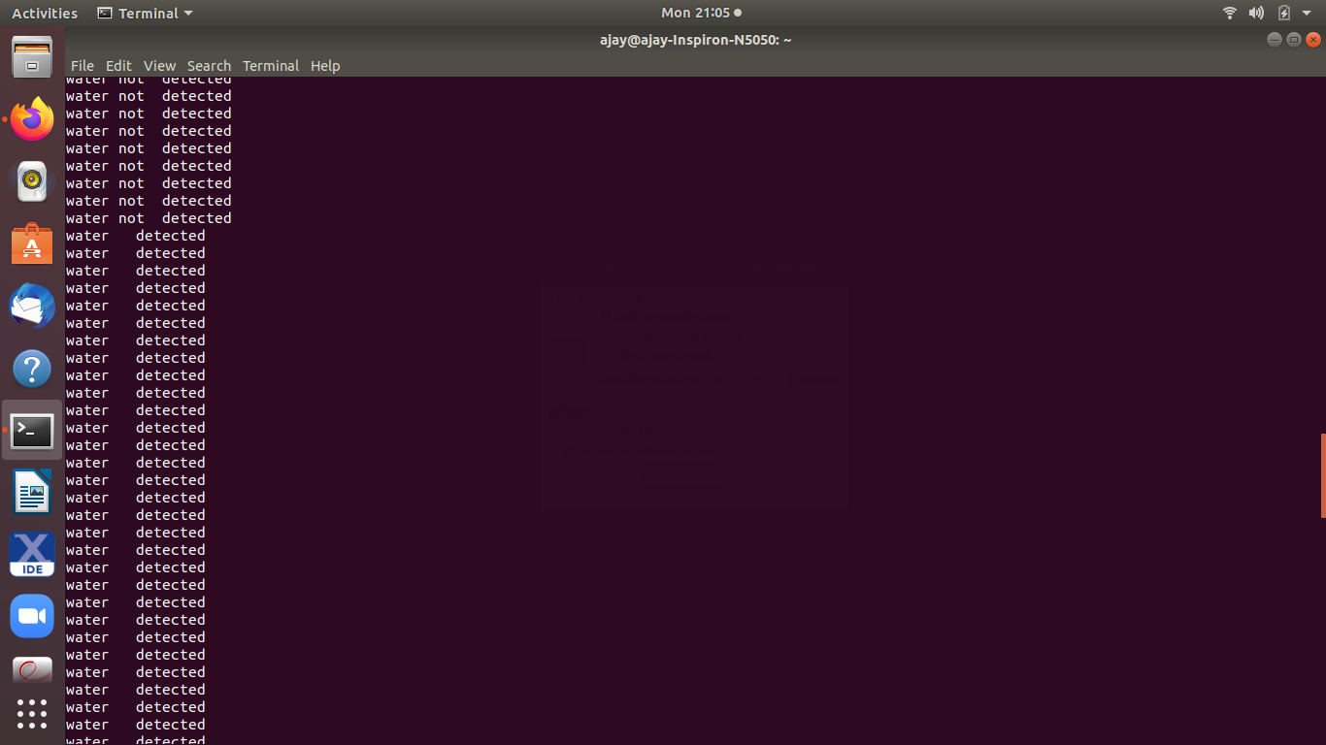

Slide 20
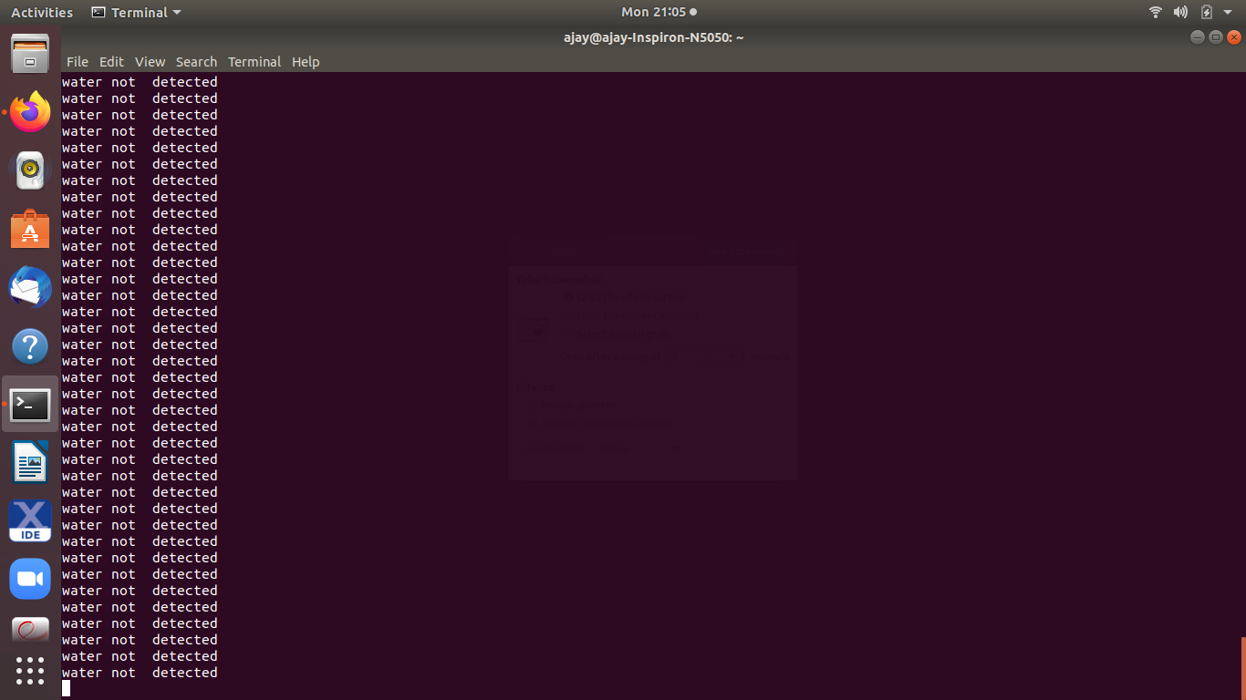

Slide 21
Pin connections
Connect Vcc to pin P9.6 of beaglebone and gnd to pin P9.2.
Connect pin D0 to pin P9.11 of beaglebone.

Slide 22
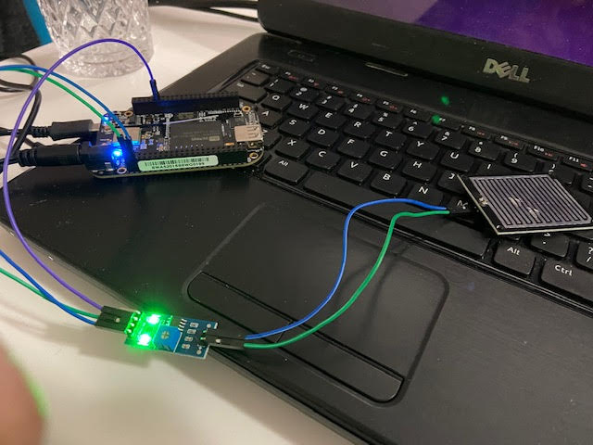

Slide 23
Iobb library
This C library allows for easy general-purpose input/output (GPIO), SPI and I2C using the BeagleBone Black (BBB) and other BBB variants.
This library is also PocketBeagle friendly.
It is easy-to-use, quite simple, and allows for reasonably speedy I/O.
The library can be downloaded and built and installed in less than a minute.

Slide 24
How to use iolib for GPIO
If you include #include <iobb.h> header file in your C source code then you’ll be able to do GPIO input/output using the following types of commands.
iolib_init() is used to initialize the library.
To set a GPIO pin to become an input or output, use the command iolib_setdir(8, 11, DigitalIn); set directions for ports .
The first digit is 8 to represent the connector P8, and the second digit is the physical pin number on the connector ie.11.
Iobb.h is simple I/o library of Beaglebone to access gpio pins.
The stdio.h header defines three variable types, several macros, and various functions for performing input and output.

Slide 25
How to use iolib for GPIO
Input can be handled with if statements, using:
if (is_low(8, 11))
or
if (is_high(8, 11))
At the end of the program, the library resources are freed up using:
iolib_free();
If you need a short delay (0-999 milliseconds), use the function shown below. For longer delays, use sleep():
iolib_sdelay_ms(100);

Slide 26
How to Install the Library
After you have set up your Beaglebone, log into your BeagleBone , and create a development type of folder and then the code can be downloaded and compiled with following commands:
mkdir development
cd development
git clone https://github.com/shabaz123/iobb.git
cd iobb
make
Next, as root user (or prepend sudo) type:
make install
The code can be compiled using:
gcc test_app.c –liofunc –o test_app

Slide 27
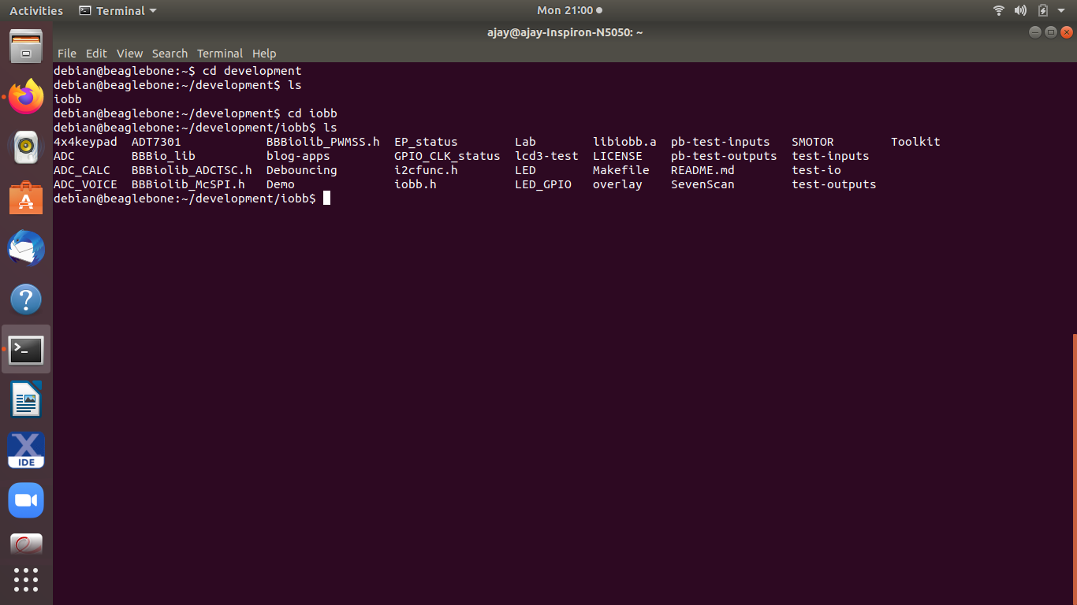

Slide 28
References
For iobb library
BeagleBone Black (BBB) and PocketBeagle I/O (GPIO), SPI and I2C Library for C – 2019 Edition
https://www.element14.com/community/community/designcenter/single-board-computers/next-genbeaglebone/blog/2019/08/15/beaglebone-black-bbb-io-gpio-spi-and-i2c-library-for-c-2019-edition#jive_content_id_Summary

Slide 29
References
Raindrops detector: Raindrop Sensor interfacing with Arduino
https://microcontrollerslab.com/raindrop-sensor-arduino-detector/
Rain drop Sensor Module
https://components101.com/sensors/rain-drop-sensor-module
Make a Rain Alert System with Raspberry Pi
https://raspi.tv/2017/make-a-rain-alert-system-with-raspberry-pi

Slide 30
References
https://www.mathworks.com/help/supportpkg/beagleboneio/ug/beaglebone-black-pin-map.html
BeagleBone Black Wireless
https://beagleboard.org/p/products/beaglebone-black-wireless
https://beagleboard.org/blog/2016-09-26-meet-beaglebone-black-wireless

